Slide 1
Heart Disease Prediction
Daniel | Jay | Donovan

Slide 2
Problem Statement
Heart disease remains one of the leading causes of mortality worldwide
This project aims to develop predictive models for heart disease using structured clinical data.

Slide 3
Project Plan
Original contained 76 variables relating to heart disease
Most research papers only used 14 of these.

Slide 4
Project Plan
Target Variable: Diagnoses of Heart Disease
Predictor Variables: Age, Sex, Chest Pain, Resting Blood Pressure, Cholesterol, Fasting Blood Sugar, Resting ECG, Max Heart Rate Achieved, Exercised induced Heart Attack, Old Peak, Slope, Number of major vessels, Resting Heart Rate

Slide 5
Added Features
age_thalach_ratio: age compared to max heart rate achieved
oldpeak_exang_interaction: a rough interaction between exercise-induced angina and ST depression

Slide 6
Models Used
Logistic Regression
Random Forest
Gradient Boosting
MLPClassifier
LSTM
GRU

Slide 7
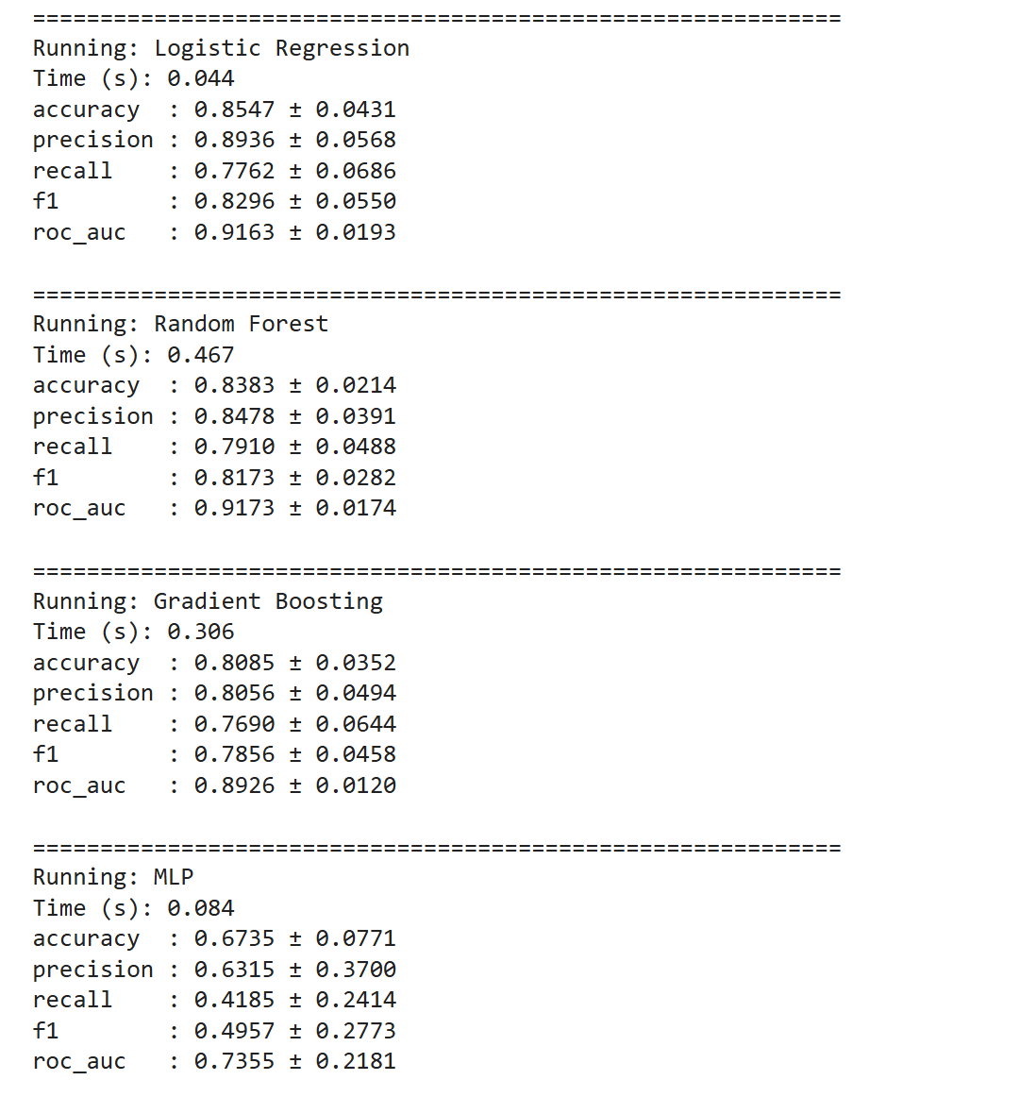
Results

Slide 8
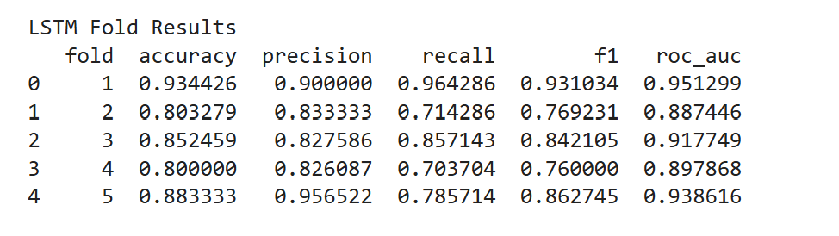
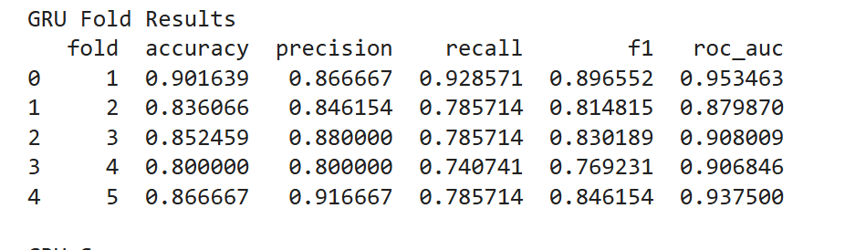
Results

